Slide 1
IMAGE COMPRESSION USING PCA
GROUP 12
SANDEEP NEEMKAR - AM.EN.U4AIE20163
VANAPALA BHARATH CHANDRA VARMA AM.EN.U4AIE20172
N.MONEESH - AM.EN.U4AIE20150
KUCHARLAPATI AKASH VARMA - AM.EN.U4AIE20141
GANDHAM SAI RAM PAVAN - AM.EN.U4AIE20125.

Slide 2
MOTIVE OF OUR PROJECT
Now a days many multimedia files like images or videos are circulated or sent in online way of mode. If the files sizes are too heavy then transmission of files will taking more amount of time for a user of decent internet signal , So to make the users more comfortable while transmission, we will be using image compression so that the size of that multimedia file will be reduced.
For image compression there are many ways to do but in our Paper we are using Principal Component Analysis(PCA).
The reason behind using pca is if we use any other techniques we need to compromise on model accuracy but using PCA will give good accuracy. The main idea of PCA is to reduce the variables in the dataset and preserve data as much as possible.

Slide 3
METHODS IMPLEMENTED IN OUR PROJECT
Taking the Data
Computing co-variance matrix
Calculating the Eigen vectors
Choosing components and forming a feature vector
Reducing the dimensions of the data set.

Slide 4
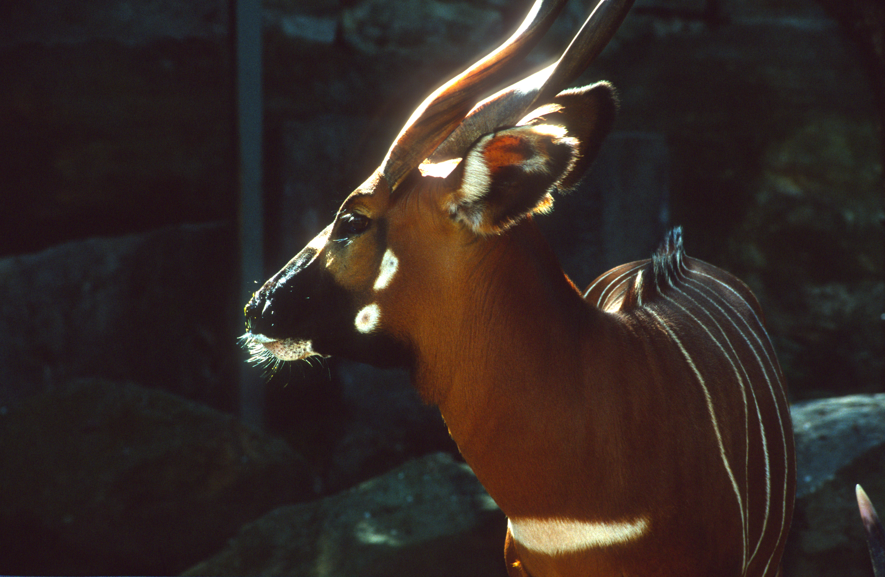
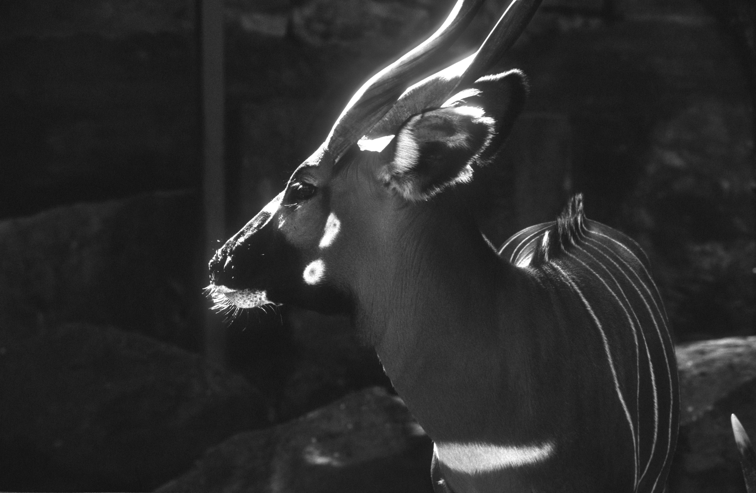
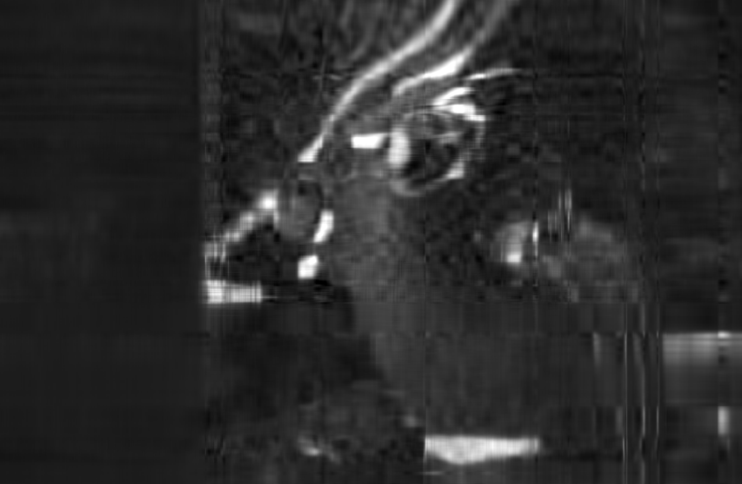
RESULTS AND DISCUSSION
RGB IMAGE GREY SCALE (INPUT,4043) COMPRESSED IMAGE(OUTPUT,20)

Slide 5
REFERENCES
Arab, Abbas, et al. “Image Compression Using Principle Component Analysis.” Al-Mustansiriyah Journal of Science, vol. 29, no. 2, 2018, p. 141., doi:10.23851/mjs.v29i2.256.
Santo, Rafael Do Espírito. “Principal Component Analysis Applied to Digital Image Compression.” Einstein (São Paulo), vol. 10, no. 2, 2012, pp. 135–139., doi:10.1590/s1679-45082012000200004.
Pramoditha, Rukshan. “Image Compression Using Principal Component Analysis (PCA).” Medium, Towards Data Science, 13 Apr. 2021, towardsdatascience.com/image-compression-using-principal-component-analysis-pca-253f26740a9f.
“PCA in Machine Learning: Assumptions, Steps to Apply &amp; Applications.” UpGrad Blog, 12 Nov. 2020, www.upgrad.com/blog/pca-in-machine-learning/.

